Slide 1




ANALYSIS OF THE HEALTH COST OF CLIMATE CHANGE DRIVEN NATURAL DISASTERS IN UGANDA
BY PATIENCE
Graduate Trainee
TAU

Slide 2

TABLE OF CONTENT
Introduction
Scope of Analysis
Power BI Utilization
Presentation of Data
Recommendations
Conclusion

Slide 3

INTRODUCTION
The dataset included historical climate change-driven natural disasters. The dataset included information on the classification, type, and subtype of these disasters, along with geographical and temporal details, magnitude, economic consequences (such as reconstruction costs and damage), and administrative information.

Slide 4
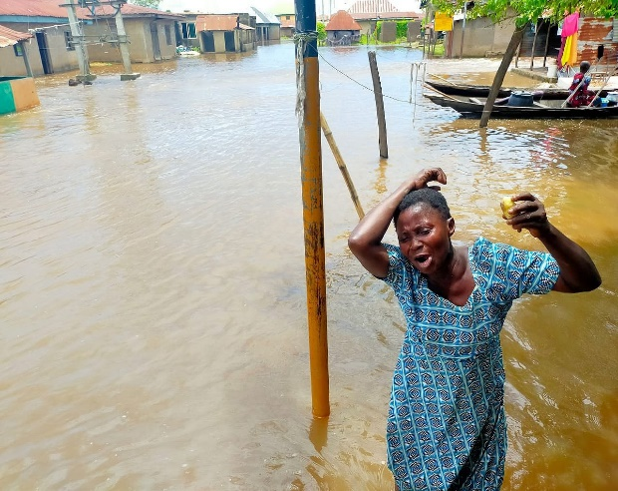

OBJECTIVES
The primary objective of this analysis is to count the health cost of climate change driven natural disasters in Uganda

Slide 5



KEY INDICATORS
Total deaths
Total CPI
Total injuries
Total Damages
Total homelessness

Slide 6
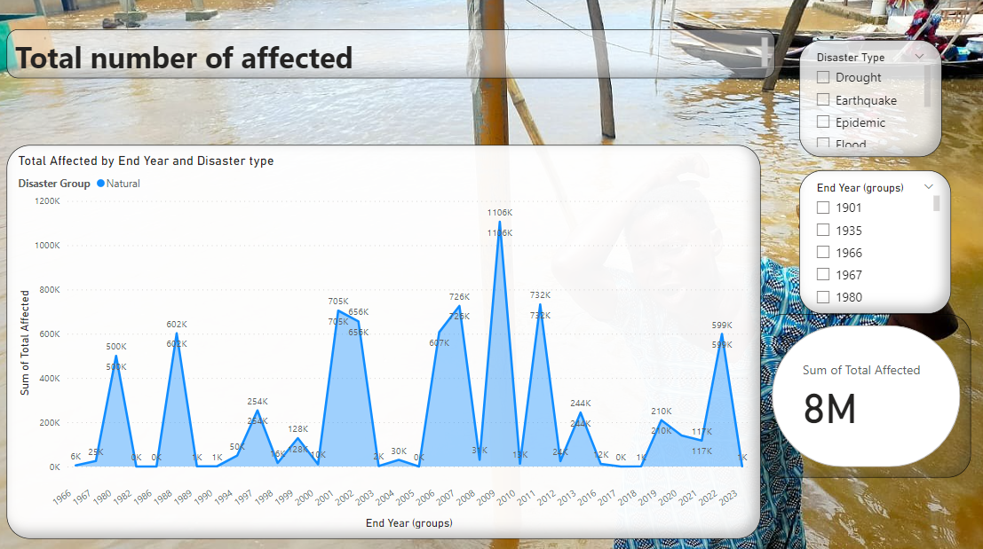
TOTAL AFFECTED
Notes:
Enrolments in all the countries individually.

Slide 7
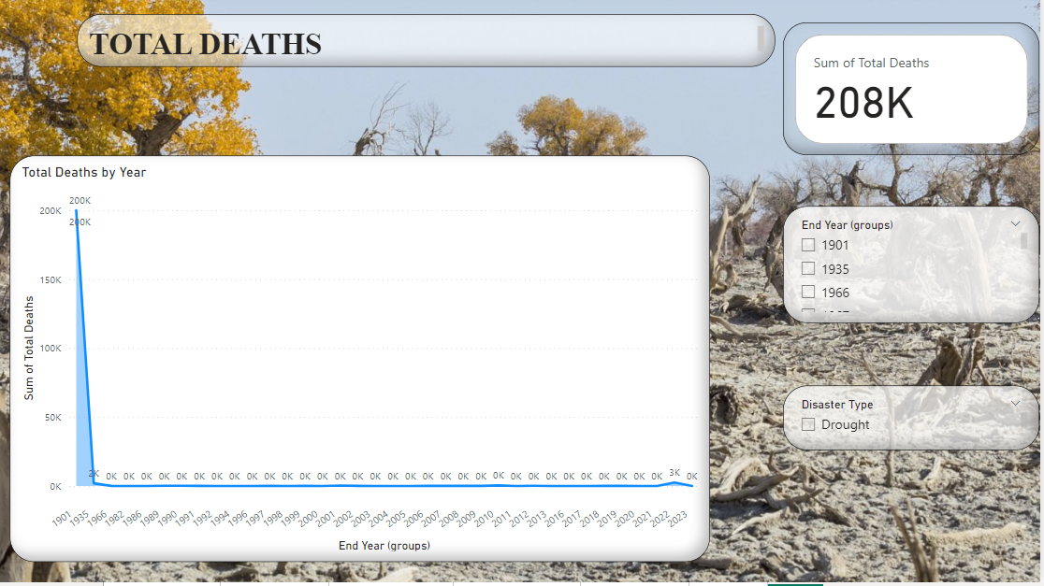
TOTAL DEATHS
Notes:
Percentage of students that get admitted from Primary and proceed to graduate

Slide 8
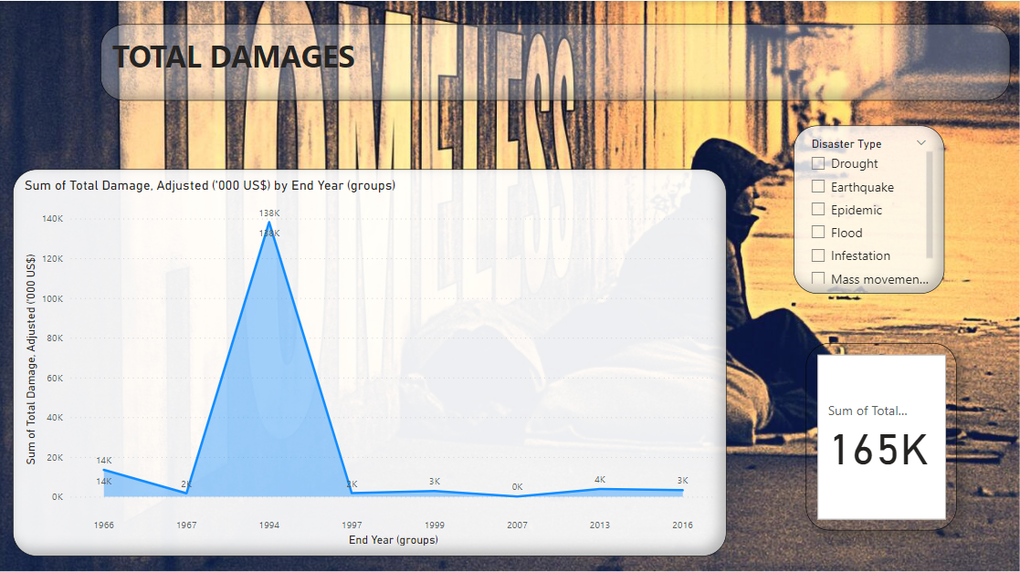
TOTAL DAMAGE COSTS(Adjusted in US$)

Slide 9
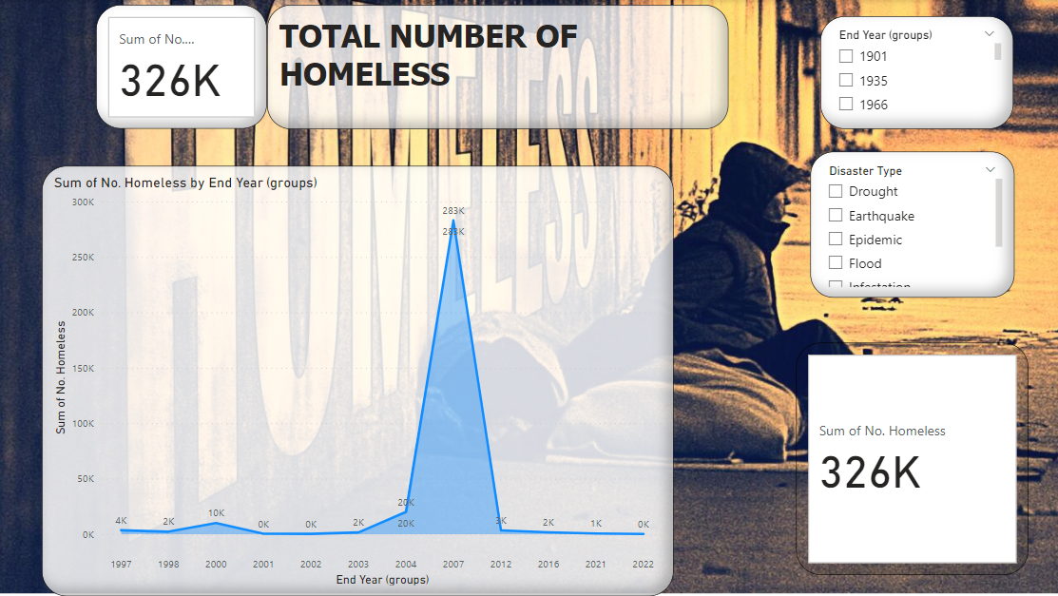
TOTAL HOMELESS

Slide 10
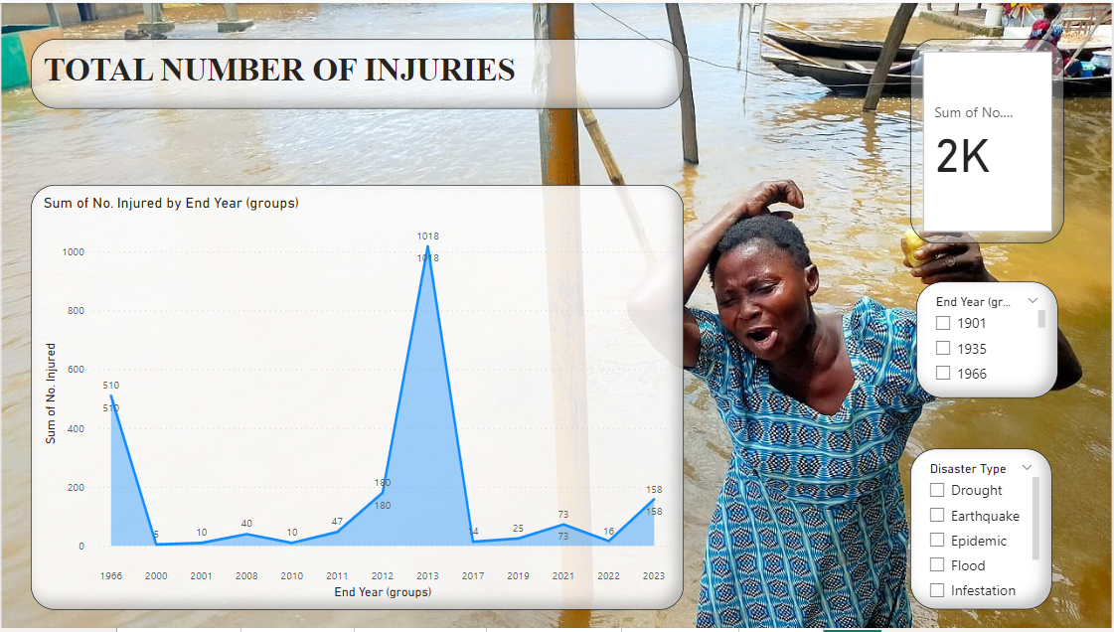
TOTAL INJURIES

Slide 11
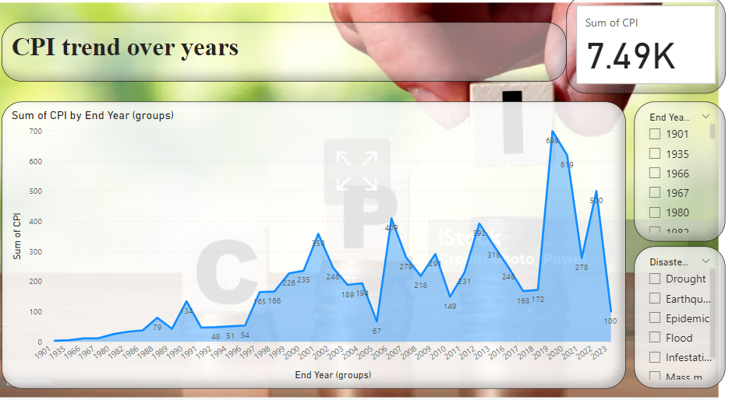
CPI trends
Notes:
Minimum qualifications for Lower and Uppwer Secondary – Average percentage

Slide 12
OBSERVATIONS
the absence of some specific details, such as river basins for certain events, might hinder a comprehensive understanding of the geographical aspects of disasters.
Additionally, variations in reporting practices over time and across regions could impact the consistency and reliability of the data.
The lack of detailed information on specific interventions and their effectiveness during epidemics could limit the insights into the public health response.
the dataset's cutoff in 2023 means that more recent developments and evolving trends might not be fully captured.

Slide 13
RECOMMENDATIONS
Sensitization of the ministry on the importance of making these data available consistently on websites
Develop clear guidelines for data collection and reporting to ensure consistency, comparability, and reliability of information, even as reporting practices evolve.
Augment the dataset with detailed information on specific interventions and their effectiveness during epidemics.

Slide 14
CONCLUSION
Uganda's experience with natural disasters spanning from 1901 to 2023 has been marked by catastrophic destruction, impacting millions of lives, causing significant economic losses, and claiming a substantial number of casualties. The findings underscore the critical importance of bolstering preparedness, response, and recovery efforts. Addressing vulnerabilities, investing in resilient infrastructure, and implementing proactive strategies are imperative to mitigate the dire consequences of future disasters and safeguard the well-being of Uganda's population.

